Slide 1
Image Captioning using Neural Networks
Rishabh Aryan Das (0536-9273)
Amit Asish Bhadra (6649-4087)

Slide 2
Contents
Introduction
Encoder (Inception v3)
Show and tell mechanism
Vector Embeddings and Tokenization
LSTM
Attention Mechanism
Model (Decoder)
Results
Conclusion
References

Slide 3
Introduction
Goal – Generate captions given an image
Dataset – COCO
Input – <image of something>

Slide 4
Introduction
Output of our model – A descriptive caption of the input image with context

Slide 5
Models and Algorithms used

Slide 6
Inception v3
Source -- Rethinking the Inception Architecture for Computer Vision by Christian Szegedy, Vincent Vanhoucke, Sergey Ioffe, and Jonathon Shlens
A CNN model that focuses on burning less computational power by reusing inceptionV3 pretrained weights on imageNet
Notes:
Image source -- https://cloud.google.com/tpu/docs/inception-v3-advanced
<number>

Slide 7
Inception v3
Architecture –
Factorized Convolutions
Smaller convolutions
Asymmetric convolutions
Auxiliary classifier
Grid size reduction
Notes:
https://blog.paperspace.com/popular-deep-learning-architectures-resnet-inceptionv3-squeezenet/
<number>

Slide 8
Inception v3
Why choose inception v3? It is used to attain >=78.1% accuracy on the ImageNet dataset and it is the best model in use currently. We expect a high accuracy on our coco dataset.
Notes:
<number>

Slide 9
Encoder
Where are we using Inception v3? We are using pre-trained weights of ImageNet using InceptionV3 for our encoder along with a CNN layer in the last output layer in encoder.
We use transfer learning for our model to extract input image features.
Notes:
https://blog.paperspace.com/popular-deep-learning-architectures-resnet-inceptionv3-squeezenet/
<number>

Slide 10
Show and Tell
Open sourced by Google
Previously trained using Inception V1, V2 and currently they’re using Inception V3
Achieved 93.9% accuracy on ImageNet
Notes:
Image source -- https://ai.googleblog.com/2016/09/show-and-tell-image-captioning-open.html
https://arxiv.org/abs/1411.4555
<number>

Slide 11
Show and Tell
Purpose – An end to end NN architecture that takes an image as input and generates a caption in English.
Architecture –
CNN that encodes an image into a compact representation like vector embeddings
RNN that generates a sentence in English using the representation
Trained to maximize the likelihood of attaining the original sentence of the corresponding image

Slide 12
Show and Tell
Features –
The encoder uses the Inception v3 for better image classification
The image model is “fine tuned” to describe the objects classified in the image
Notes:
Image source -- https://ai.googleblog.com/2016/09/show-and-tell-image-captioning-open.html
<number>

Slide 13
Show and Tell
In the “fine tune” stage, the image is trained with both the visual aspect as well as language aspect with human generated captions
Notes:
Image source -- https://ai.googleblog.com/2016/09/show-and-tell-image-captioning-open.html
<number>

Slide 14
Vector Embeddings
What are vector embeddings?
Technique for language modelling and feature learning
Words or phrases from vocabulary are mapped to vectors real numbers
Involves a mathematical embedding from a space with many dimensions per word to a continuous vector space with a much lower dimension
This is done by the last layer of the encoder model which is a fully connected layer.

Slide 15
Tokenizing the input captions
We are tokeninzing the input captions
<start> is the starting tokenizer while <end> is the terminating tokenizer
As soon as the decoders encounters <end> it will know that a full sentence has been generated

Slide 16
Tokenizing the input captions
It will look something like this --

Slide 17
LSTM
Long Short Term Memory
Where are we using LSTM? We use LSTM in our decoder where we implement the Attention Mechanism.
Gated structure containing forget gate, input gate and output gate
Notes:
https://arxiv.org/abs/1412.3555
Image Source -- https://colah.github.io/posts/2015-08-Understanding-LSTMs/
<number>

Slide 18
Attention Mechanism
Why choose Attention over seq2seq – Utilizes all hidden states of the input phase during the decode phase. So instead of a single context vector after encoding, we make the model learn how to generate a context vector for every output time state
Types of Attention – 1. Bahdanau Attention 2. Luong Attention
Notes:
https://blog.floydhub.com/attention-mechanism/
https://hackernoon.com/attention-mechanism-in-neural-network-30aaf5e39512#:~:text=Attention%20Mechanism%20allows%20the%20decoder,for%20each%20output%20time%20step.
<number>

Slide 19
Attention Mechanism
Computation of context vector for each time step – Assume the encoder generates h₁..h_{t} for the inputs x₁..x_{t} . h₁..h_{t} Then context vector c_{i} for each time step is given by -- a – alignment model (feedforward NN) e – how well encoded input h matches the output of the decoder s

Slide 20
Attention Mechanism
Computation of context vector for each time step (contd) Alignment scores are normalized using a softmax function – Finally, the context vector is calculated as a weighted vector --

Slide 21
Attention Mechanism
Where are we using Attention? We use it in the decoder. Not only can all the input words be taken into account in the context vector but relative importance should also be given to each one of them.

Slide 22
Our Model
Predicted Captions
CNN
Inception V3
Notes:
Image Source -- https://www.researchgate.net/publication/315096573_Multichannel_End-to-end_Speech_Recognition
<number>

Slide 23
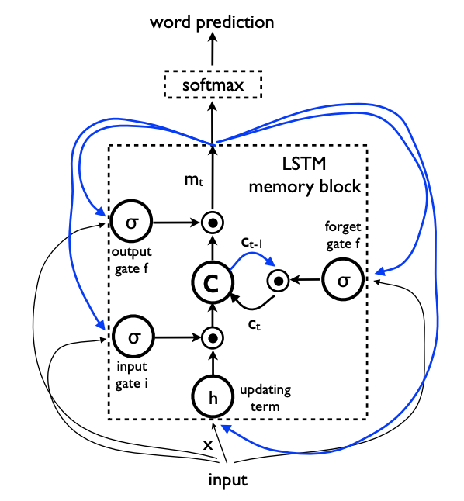
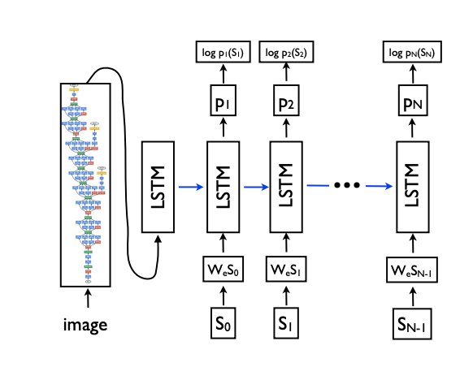
Decoder model structure

Slide 24
Categorical Cross Entropy Loss
Also called the softmax loss
It is a combination of the softmax activation with cross entropy loss
Outputs a probability over N classes for each image
Used for multi class classification

Slide 25
BLEU Score
BLEU stands for Bilingual Evaluation Understudy
It is an algorithm used to evaluate the quality of machine translated text
It is language independent
Easy to understand
Gives a probability distribution. Higher the score the better the quality of the caption.

Slide 26
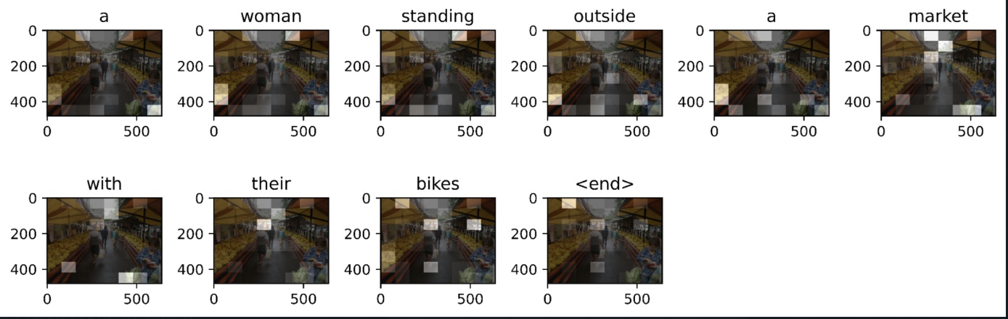
Results
Attention plot of a sample image describing a woman in a market place

Slide 27
Conclusion
The COCO dataset is a huge dataset with size about 13 GB
Training 10 epochs in NVIDIA RTX 2080 requires 4 hours of time.
Captions generated with this method are of standard human readable quality.
The performance can be improved by implementing a generative pre-trained transformer in the decoder.
GPT will speed up the training process significantly and generate captions with better quality.

Slide 28
References
Each slide has the corresponding sources in the Notes.
Research papers –
https://arxiv.org/abs/1411.4555
https://arxiv.org/abs/1411.4555
http://www.bioinf.jku.at/publications/older/2604.pdf
https://arxiv.org/abs/1412.3555
Here are all of them and few more that we referenced –
https://cloud.google.com/tpu/docs/inception-v3-advanced
https://blog.paperspace.com/popular-deep-learning-architectures-resnet-inceptionv3-squeezenet/
https://ai.googleblog.com/2016/09/show-and-tell-image-captioning-open.html

